Slide 1

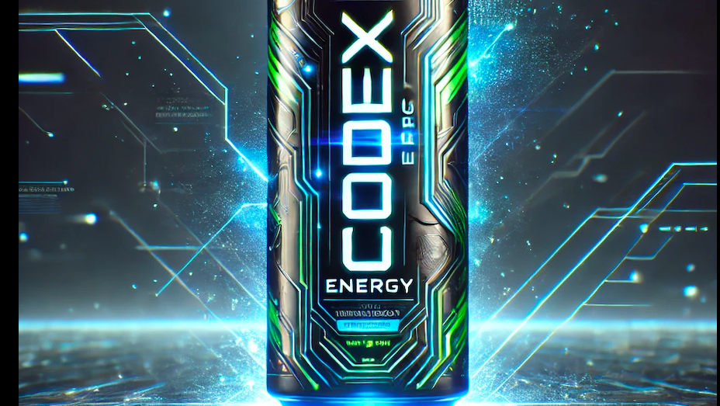

CODEX
Food and Beverage Industry

Slide 2
Overview
CODEX is a German beverage company that is aiming to make its mark in the India market
Recently the company introduced its new energy drink in 10 Indian cities.
They conducted a survey in those 10 cities and received results from 10k respondents.

Slide 3
Objective
Analyze the data to uncover patterns, insights related to consumer behavior, preferences of energy drinks, specifically Codex.
Based on the insights extracted, provide recommendations that can enhancing brand awareness, increasing sales, and targeting the right audience.
To prepare a visually appealing and engaging presentation that effectively communicates the insights and recommendations .

Slide 4
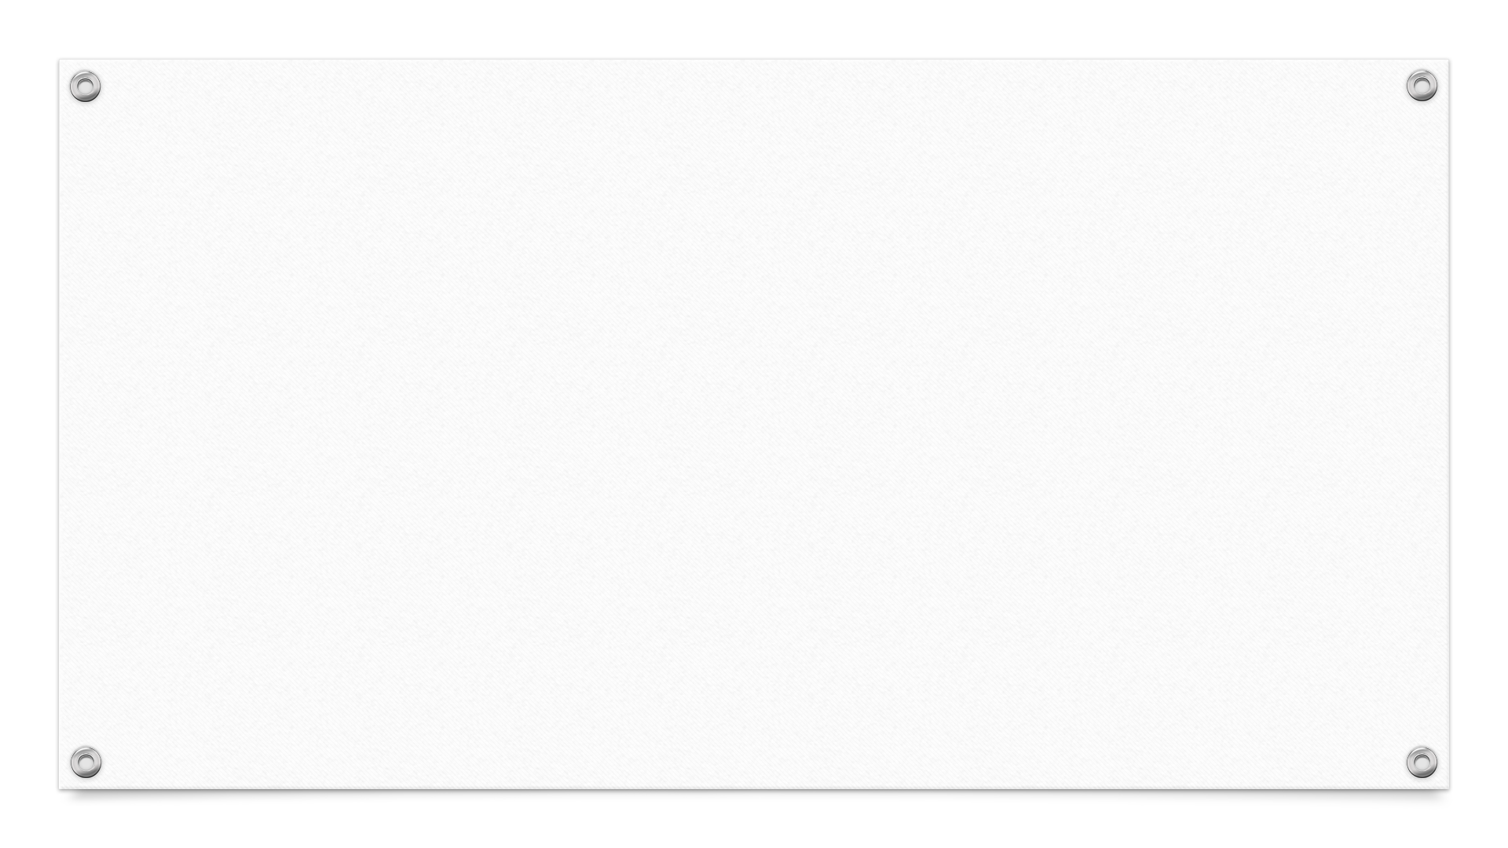
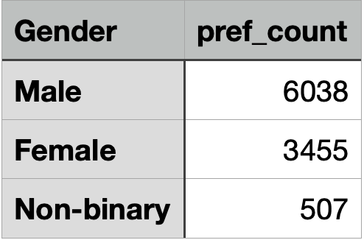
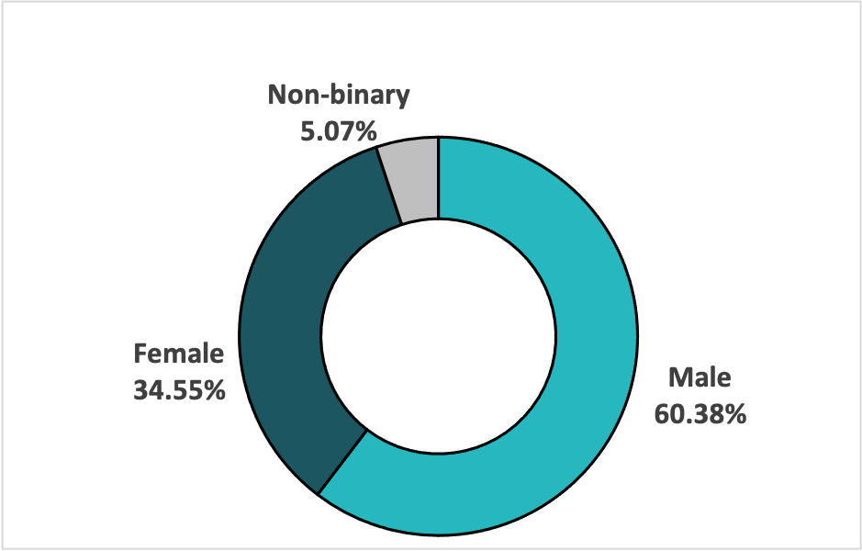
Demographic Insights
Who prefers energy drink more(male/female/nonbinary?)
There are significantly more males (60%) in a group of energy drink consumers indicating higher preference for energy drinks among males.

Slide 5
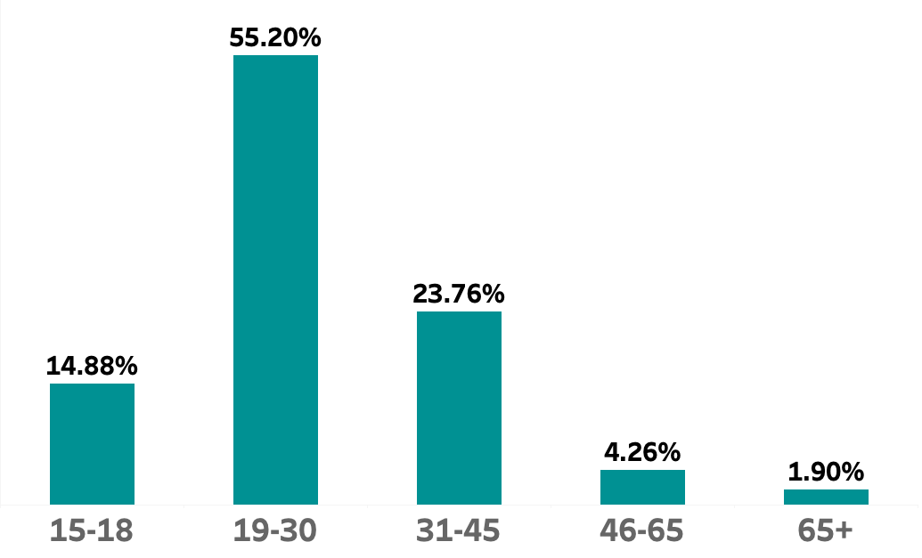
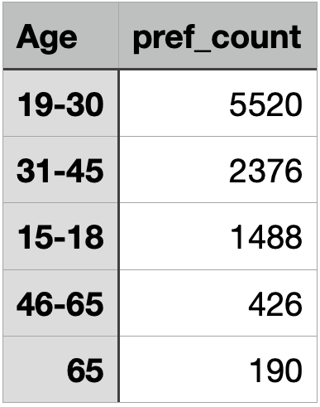
Demographic Insights
Which age group prefers energy drinks more?
Among the respondents majority of consumers (55%) are in the age group of 19-30 indicating preference for energy drinks among young adults.

Slide 6
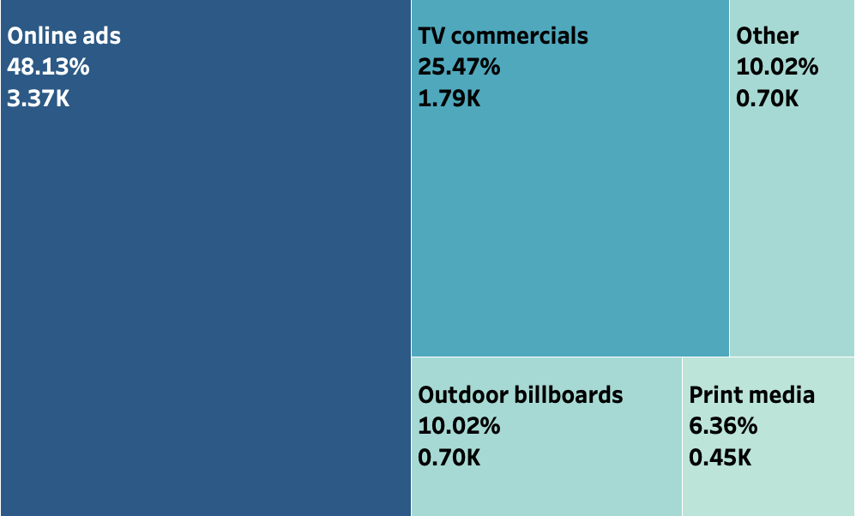
Demographic Insights
Which type of marketing reaches the most Youth (15-30)?
Online advertising is the most effective channel for reaching the youth aged 15-30.
With its 48% contribution this marketing channel outperforms other media.

Slide 7
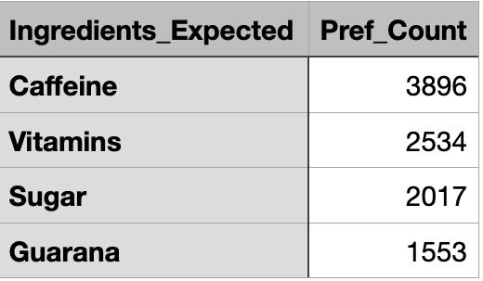
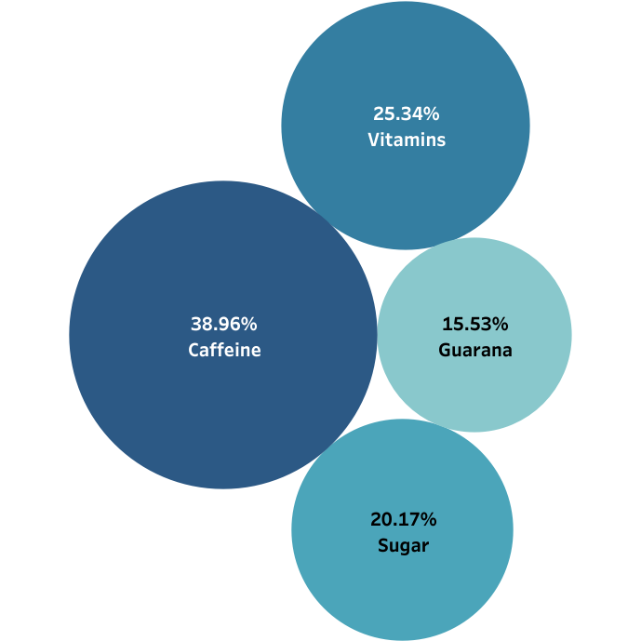
Consumer Preferences
What are the preferred ingredients of energy drinks among respondents?
Caffeine is the most popular ingredient among energy drink consumers preferred by 3.9k individuals.
Vitamins also have a significant preference .
Sugar is preferred but not as much as caffeine and vitamins.
Guarana is the least preferred ingredient.

Slide 8
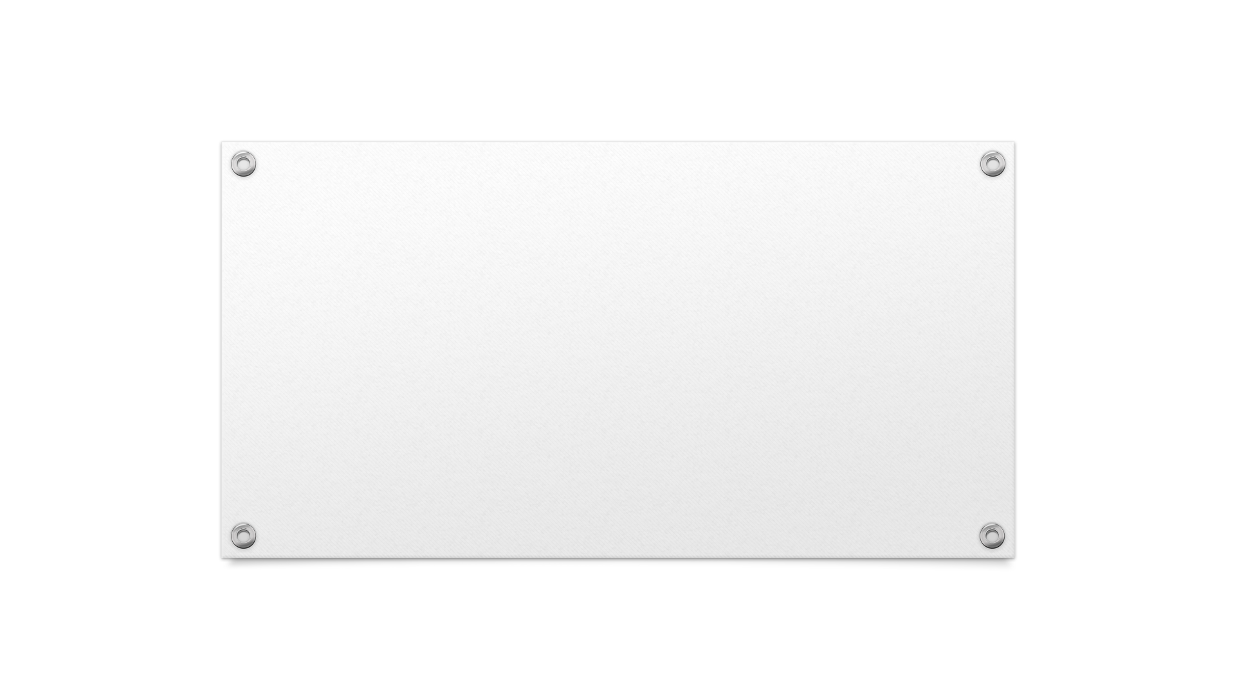
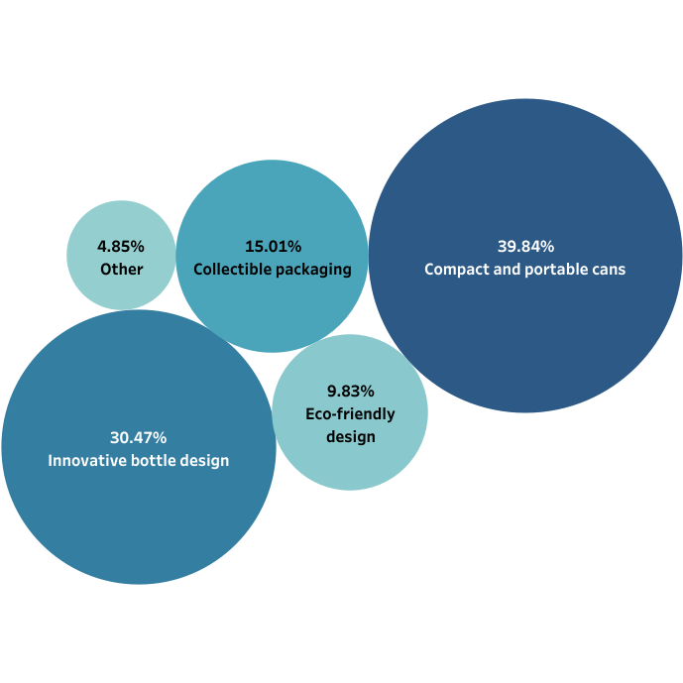
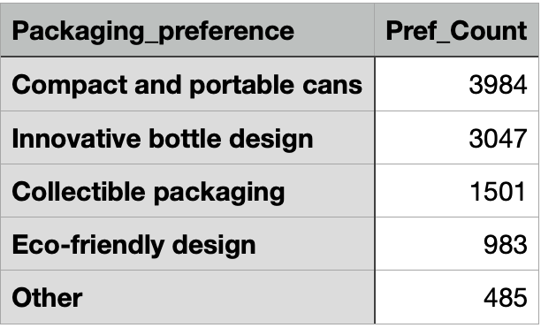
Consumer Preferences
What packaging preferences do respondents have for energy drinks?
Compact and portable cans are the most popular packaging preferred by approximately 40% consumers. Around 3k people prefer innovative bottle design ,1.5 k prefer collective packaging.

Slide 9
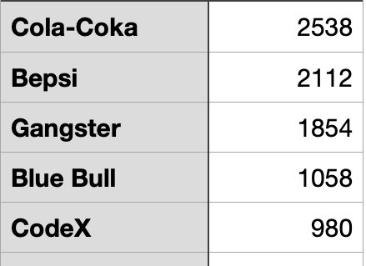
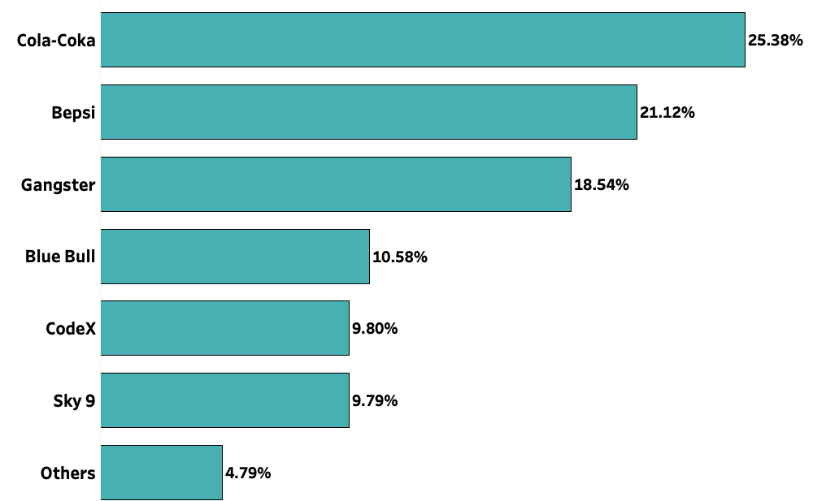
Competition Analysis
Who are the current market leaders?
Cola-Coka with 25% share, popular among 2.5k respondents is the current market leader followed closely by Bepsi (21%) and Ganster(18%).

Slide 10
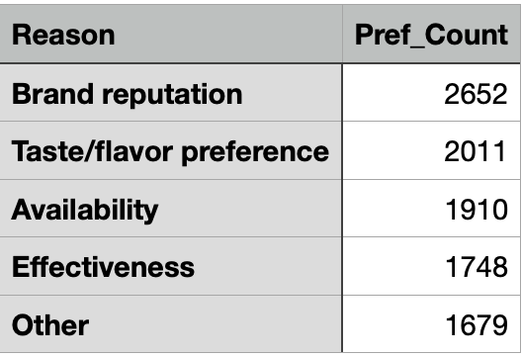
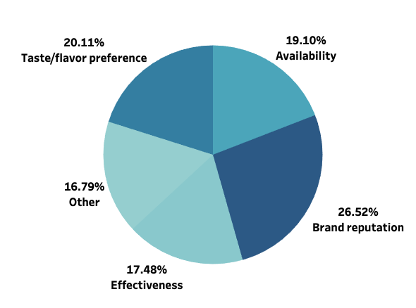
Competition Analysis
What are the primary reasons consumers prefer those brands over ours?
Brand reputation is cited as primary reason by 2.6k responders showcasing its impact on customer choice.
Around 2k customers preference was impacted by taste/flavor.
Availability and Effectiveness also had noticeable impact on customer preference.

Slide 11
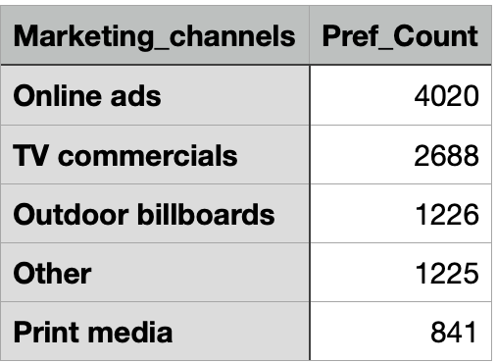
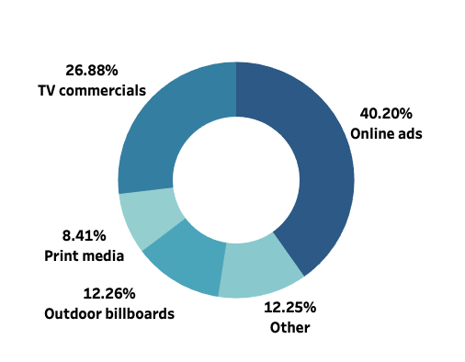
Marketing Channels and Brand Awareness
Which marketing channel can be used to reach more customers?
Online advertisement is the most effective marketing channel especially among young individuals who are more likely to engage in online content.
TV commercials can be used as a channel to garner other individuals

Slide 12
Marketing Channels and Brand Awareness
How effective are different marketing strategies and channels in reaching our customers?
Online Ads
Most effective marketing channel to target young adults.
Ads can be showed based on user interests.
Effectiveness of strategies can be tracked.
TV commercials
Can be used to garner large, diverse consumers.
Being on TV provide credibility to the brand.
Can be used to cater those customers who are not covered via online ads.
Outdoor billboards ,print media are comparatively less effective.

Slide 13
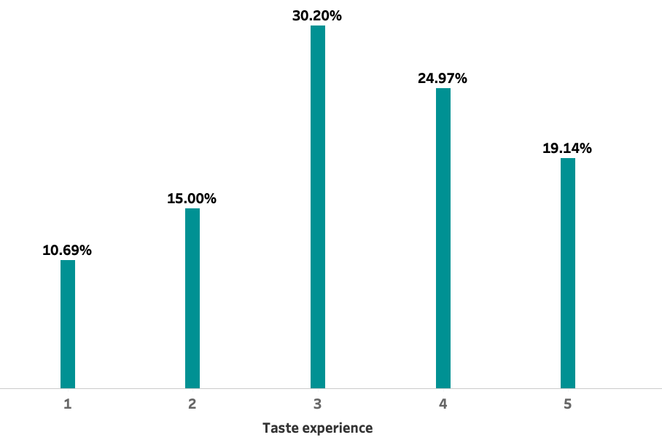
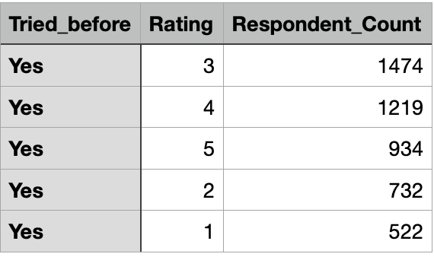
Brand Penetration
What do people think about our brand? (overall rating)
3.27 is the overall rating obtained from average of individual ratings by 4881 customers who have tried our product. Nearly half of the customers gave rating of 3 or 4.
Overall Rating
3.27

Slide 14
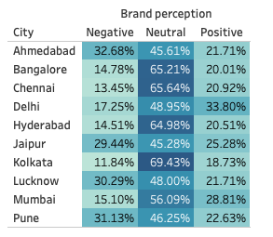
Brand Penetration
Which cities do we need to focus more on?
Ahmedabad, Pune, Lucknow, Jaipur have higher proportion of negative brand perception implying need to focus on these citied to improve perception.
We should also focus on cities with neutral stance as there is scope of improvement .

Slide 15
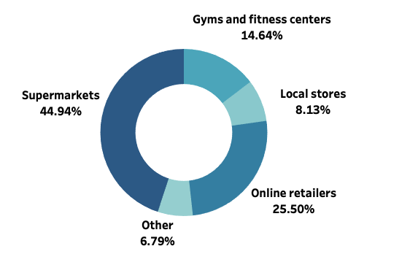
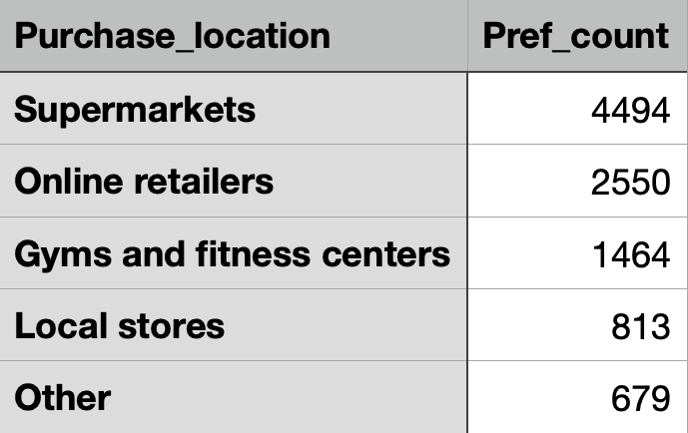
Purchase Behavior
Where do respondents prefer to purchase energy drinks?
Most of the respondents prefer to purchase energy drinks from Supermarkets (45%) followed by online retailers (25%).​

Slide 16
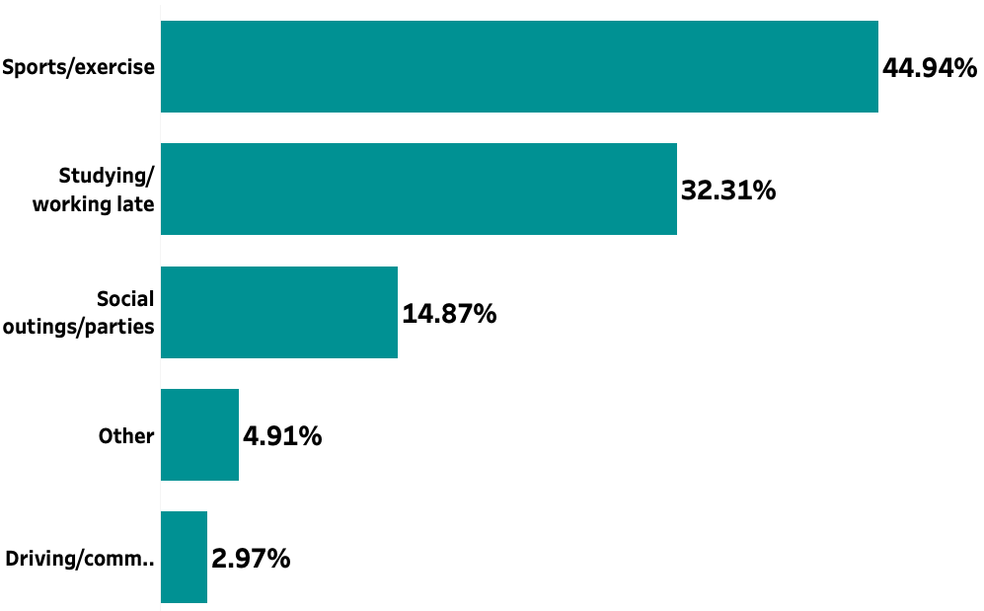
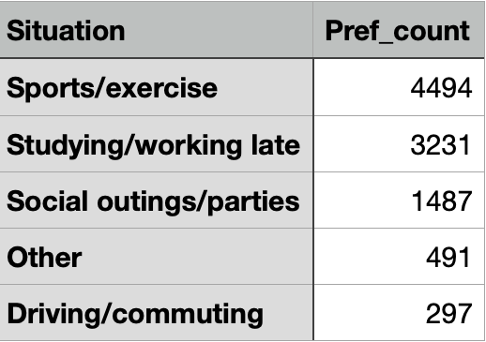
Purchase Behavior
What are the typical consumption situations for energy drinks among respondents?
Majority of the respondents drink energy drinks before or after sports/exercise​

Slide 17
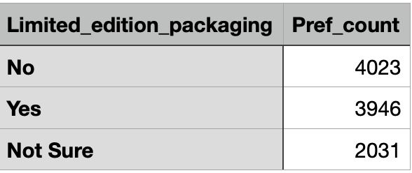
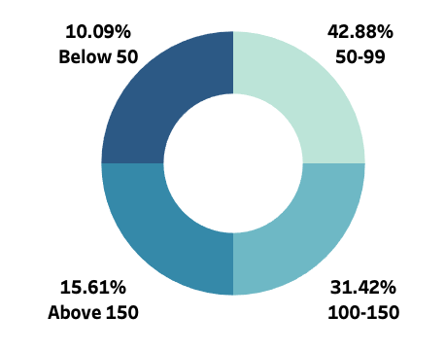
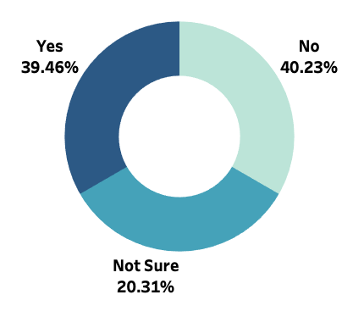
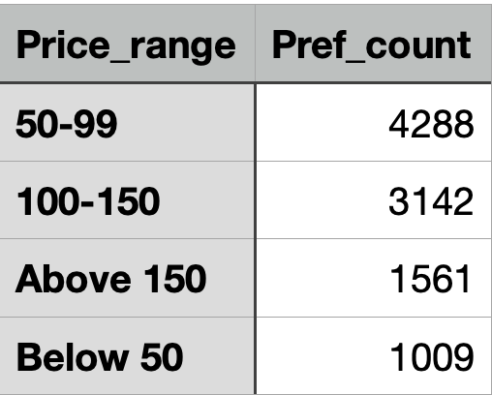
Purchase Behavior
What factors influence respondents' purchase decisions, such as price range and limited edition packaging?
43% of respondents consumed the energy drinks priced between 50-99 indicating strong demand for more affordable options.
31 % consumers are willing to spend more(100-150), suggesting a market for premium products.
40% consumers are not interested in limited edition packaging, suggesting that a significant portion of the audience prefers standard packaging.
Around 39% shoe positive response towards limited edition packaging.

Slide 18
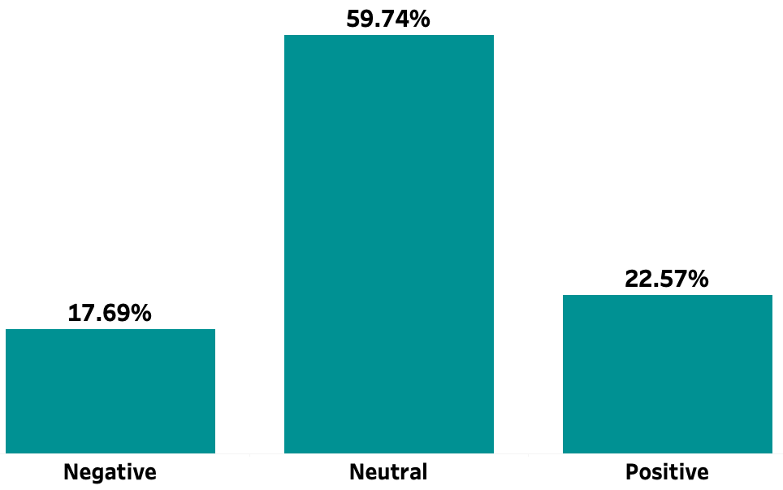
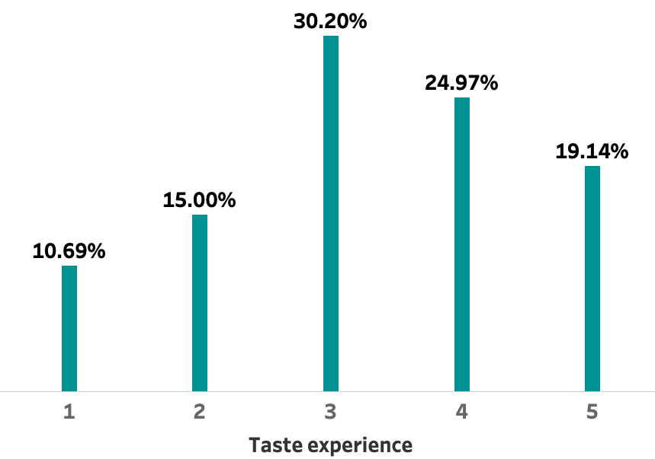
Product Development
Which area of business should we focus more on our product development? (Branding/taste/availability)
Around 60% consumers have neutral and 18% have negative perception of our brand which indicates there is room for improvement.
30% of consumers have rated the product as 3 and 25% of them as 4 efforts can be made to improve taste experience of these consumers

Slide 19
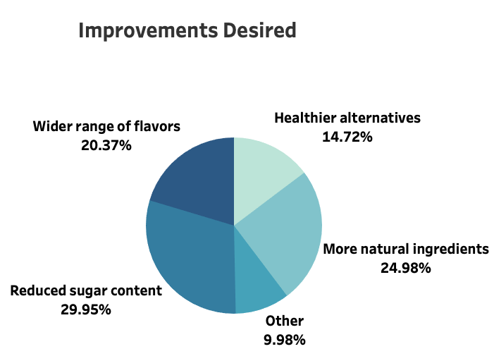
Recommendations
What immediate improvements can we bring to the product?
Cater to the improvements desired by respondents
Reducing sugar content:
Use alternatives like stevia or monk fruit that can provide sweetness without the calories of traditional sugar.
Make sure to maintain quality .
Natural ingredients:
Eliminate artificial preservatives and colors and prioritize high-quality, natural ingredients sourced from reputable suppliers.
Flavor enrichment:
Conduct surveys to identify popular flavors and emerging trends.
Introduce limited-time flavors to keep the product line fresh.
Refine your offerings based on consumer feedback and preferences.

Slide 20
Recommendations
Heathier alternatives:
Add vitamins, minerals, and electrolytes to improve the overall health profile of your drinks.
Clearly label health benefits to attract health conscious consumers.
Availability:
Collaborate with grocery stores, convenience stores, gyms, and health food stores to stock your product.
Partner with local distributors to reach smaller retailers and niche markets.

Slide 21
What should be the ideal price of our product?
We previously observed that most customers(43%) are buying products in the 55-99 price range and 31% in 100-150 range .Idea price should be based on these findings.
1.Mid-range pricing:
A price around 75-95 could effectively capture customers from both segments increasing our customer base.
2.Pricing in 55-99 range:
This price range aligns with the majority of consumers who are already purchasing in this segment,
increasing the likelihood of attracting price-sensitive buyers. But make sure to ensure the quality.
3.Competitive pricing:
Need to make decision based on price of similar drinks in Indian market which is around 30-100 price
range depending on brand ,packaging, ingredients.
Consider launching at a price range 65-85 and monitor sales and consumer feedback.
Price in the 55-99 range is likely beneficial, given the purchasing behavior of most customers. This can help you establish a foothold in the market and attract a wider customer base.

Slide 22
What kind of marketing campaigns, offers, and discounts we can run?
Collaborate with fitness influencers to promote the product. This gives authenticity to the product because influencers share their genuine experience and results.
Launch campaigns around major holidays or special events like New Year resolutions to encourage consumers to try your drink as part of their lifestyle changes.
Sponsor local sports events :This will increase our brand visibility ,helps to connect to audience directly, helps audience to make informed decisions.
Offer existing customers a discount for referring friends.
Offer limited time discount for first time buyer which is a way to make more people try our product .

Slide 23
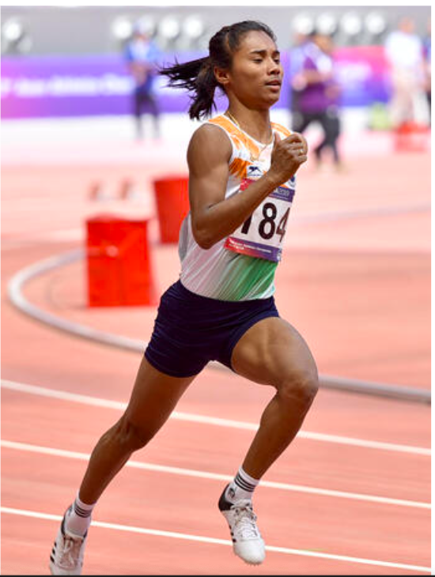
Who can be a brand ambassador, and why?
HIMA DAS
Hima Das is a prominent Indian sprinter known for her impressive achievements in athletics, particularly in the 400 meters and 200 meters events
During 2018 IAAF World U20 Championships in Finland she won a gold medal in the 400 meters, becoming the first Indian woman to win a gold medal at a world-level event.
She won silver in the 400 meters and gold in the 4x400 meters relay at the Asian Games held in Jakarta.
She has received the Arjuna award.
She has brought recognition to India at global level her being our product's ambassador can evoke sense of patriotism.
Her energetic persona and achievements can attract a younger demographic .
She actively promotes sports and fitness, making her a suitable ambassador for brands focused on health and energy.
She has a significant following on social media helps us to reach wider audience.
She can participate in promotional events, campaigns, and social media challenges enhancing product's visibility.

Slide 24
Who should be our target audience, and why?
Young Adults (18-34):
Individuals in this age group are often involved in studies , work, social activities .This kind of busy and dynamic lifestyle drains their energy as a result they seek energy drinks to replenish their energy to keep up with their demanding schedules.
Athletes and Fitness Enthusiasts :
Energy drinks provide a quick boost in energy, helping athletes to perform better.
Caffeine ,a constituent of energy drink can improve mental alertness and focus.
The stimulating effects of energy drinks can provide a psychological boost.
Health-conscious individuals:
These individuals have very high health values, they select energy drinks that align with their health values.
They often seek low-calorie or zero-sugar options ,natural ingredients

Slide 25
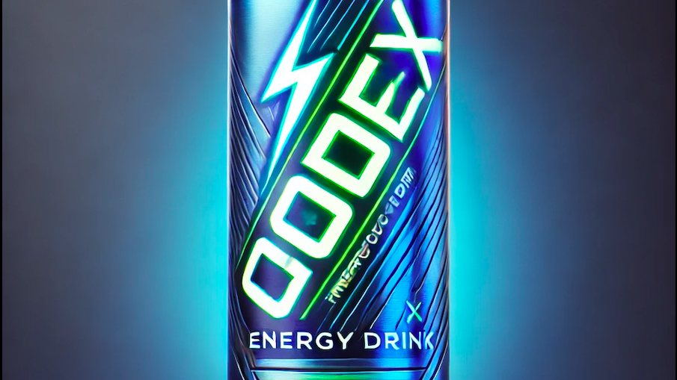
Thank You

